Slide 1
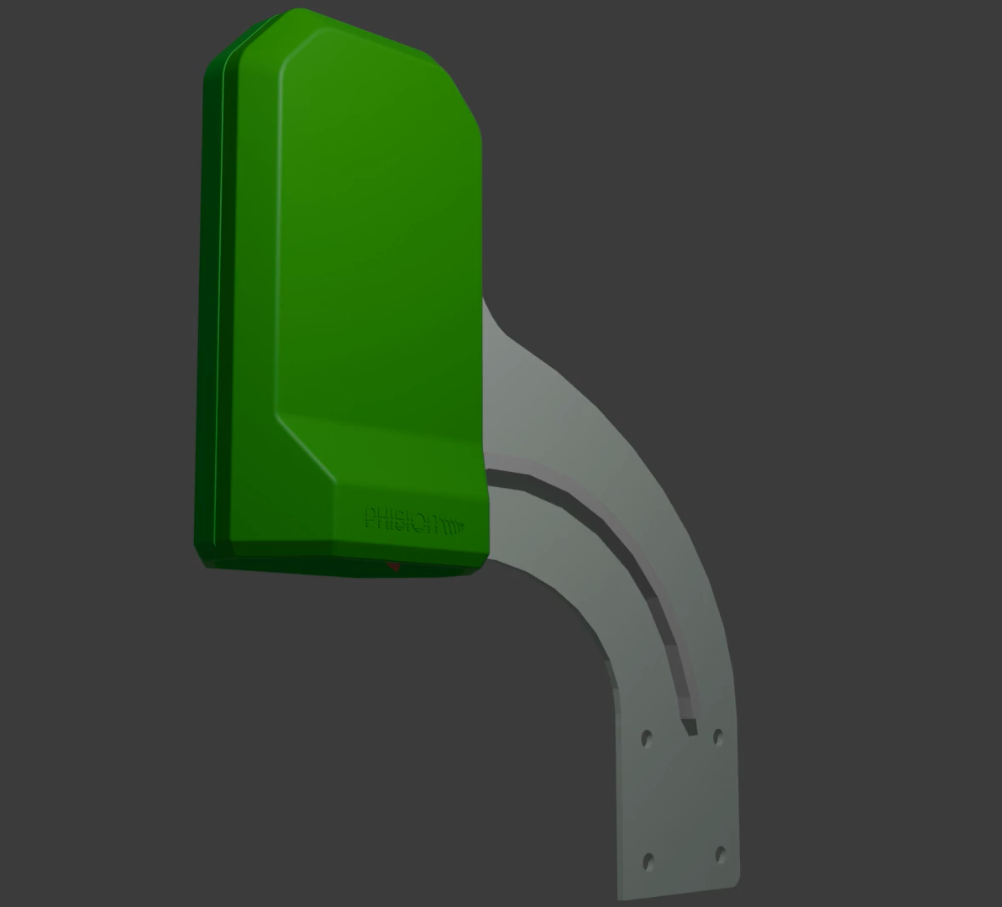
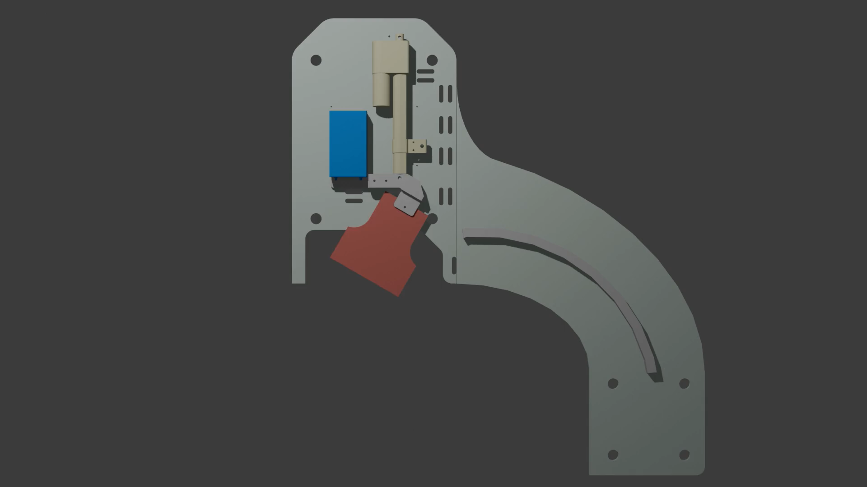
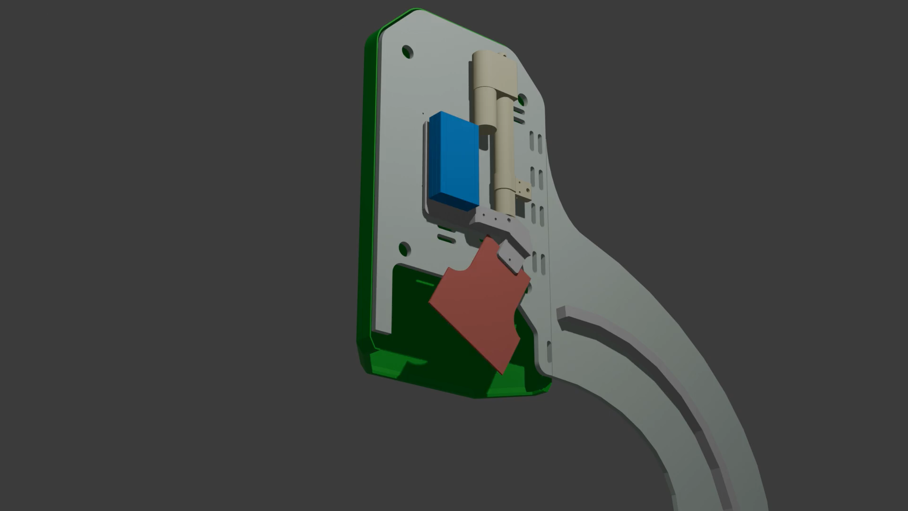

Slide 2
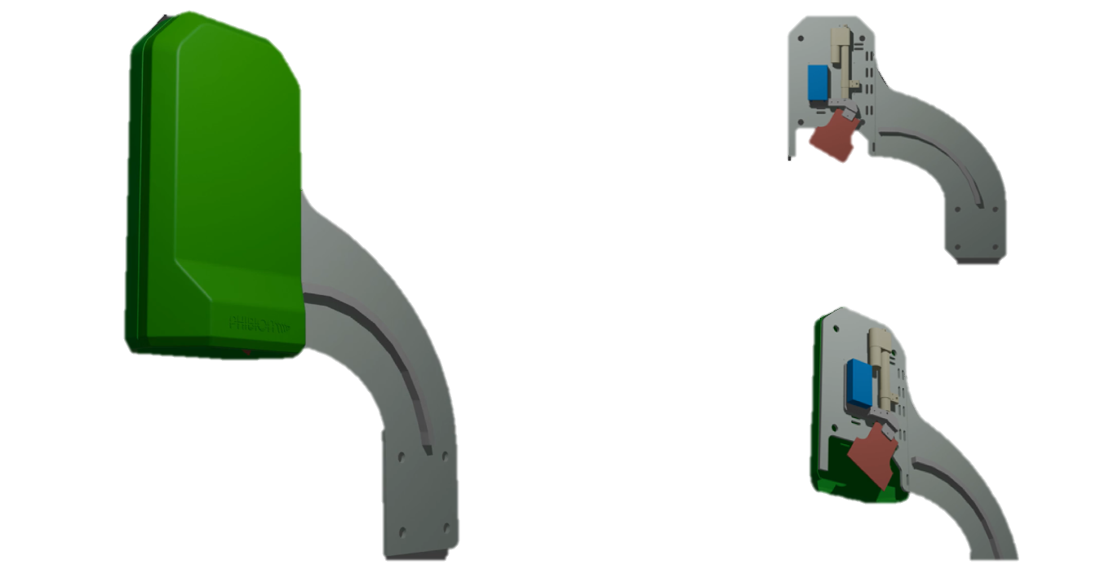

Slide 3
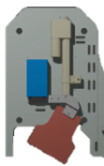
Volume1 = Area * Height (RL1) after pour (zero baseline)
Volume2 = Area * Height (RL2) after cycle
Pour Volume = Rate * Time
Volume3 = Volume2 + Pour Volume (RL3)
MudMaster = 32Ha
After initial pour (Volume1), a 42 day operation cycle begins;
The tailings is dewatered to a new RL2;
A new pour can begin and fill to original RL1, this provides displacement;
The new pour is complete to a new 900mm depth (Volume(30)
Volume(3)
RL(3)
Baseline
Volume(1)
RL(1)
900mm
Volume(2)
RL(2)
AREA (A)
Ignored measurement to simplify calculation

